Slide 1

Objectives
understand meaning of “increase/decrease in demand”
identify factors that shift the demand curve
distinguish between movement & shift of demand curve

Slide 2
Determinants of Demand:
Factors that influence demand
Shift in the demand curve
Changes in the conditions of demand

Slide 3
Shifting of the demand curve
Non-price determinants
  Causes a shifting of the entire demand curve
  Price of the product itself remains constant
An increase in demand – the demand curve shifts rightwards – more is bought at the same price
A decrease in demand – the demand curve shifts leftwards – less is bought at the same price
THESE CHANGES ARE KNOWN AS A CHANGE IN DEMAND – CAUSED BY CHANGES IN NON-PRICE DETERMINANTS.

Slide 4
An increase in demand
P
Price
D₀
D₁
O
Q₀
Q₁
fig 2.2
Quantity

Slide 5
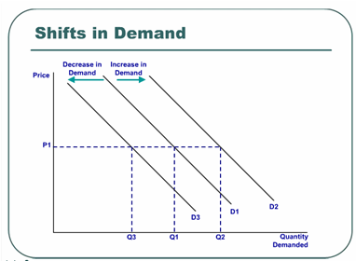

Slide 6
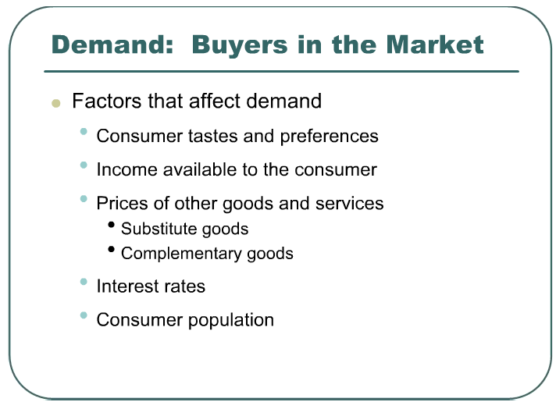

Slide 7
Factors influencing demand
Future price expectations – the higher the future price expectation, the higher the current demand
Exchange rates – influences demand for exports and imports
Interest rates – the higher the r, the higher the cost of borrowing, the lower the demand
Population – the higher the population growth, the higher the demand for normal goods

Slide 8
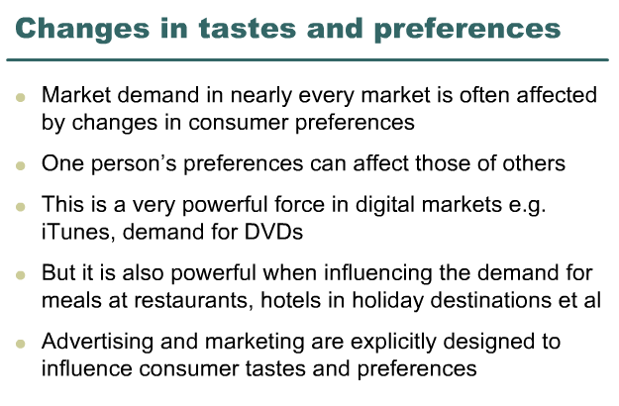

Slide 9
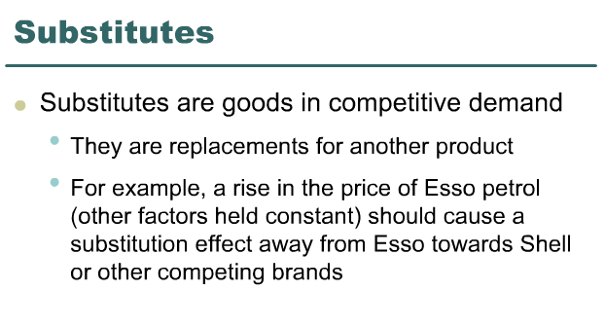

Slide 10
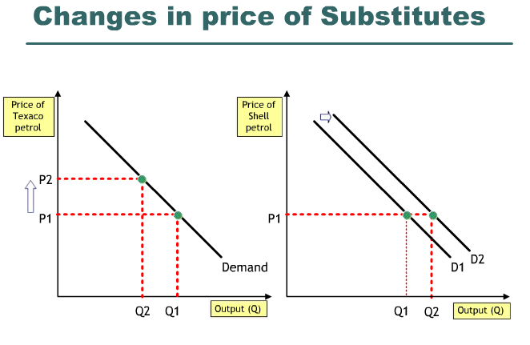

Slide 11
Determinants of demand
The number and price of complementary goods
  Goods consumed together
  Cars and petrol, fish and chips
  The higher the price of complementary goods, the fewer of them will be bought and hence the less the demand for this good

Slide 12
Determinants of demand
Income
  As people’s income rises their demand for most goods will rise – normal goods
  Inferior goods: as people get richer, they spend less on inferior goods and switch to better quality goods – demand decreases as income rises

Slide 13
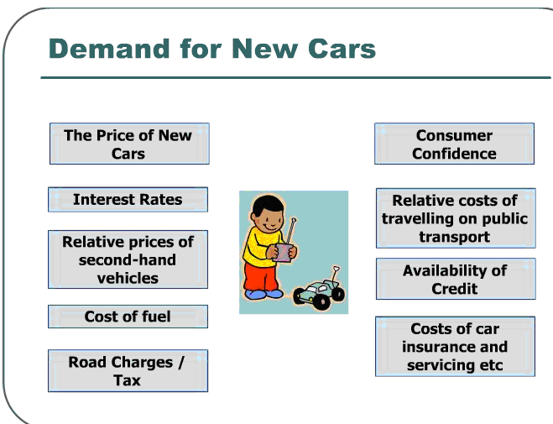

Slide 14
MOVEMENT VS SHIFTING
MOVEMENT
  Caused by changes in the price of the product itself, ceteris paribus
  Causes either an upwards or downwards movement along the same demand curve
  Known as a change in quantity demanded
SHIFTING
  Caused by changes in the non-price determinants, price of the product itself remains constant
  Causes the entire demand curve to shift either to the left or to the right
  Known as a change in demand

Slide 15
CLASS ACTIVITY
DISTINGUISH BETWEEN A ‘CHANGE IN DEMAND’ WITH A ‘CHANGE IN QTY DEMANDED’.
WHAT CAUSES A MOVEMENT ALONG AND A SHIFTING OF THE ENTIRE DEMAND CURVE.

